Slide 1
NYC Pre-Kindergarten School Quality Report 2017-2018
August 2020

Slide 2
Summary
The 2017-2018 School Quality Report - Pre-K Programs was published on July 21, 2020 and includes data on over 1,600 Pre-K programs. The data was sourced from an API provided by the NYCDOE.
Identified “top schools” based on parent and collaborative teacher responses that were greater than 90 and determine if parent survey scores can be projected based on enrollment, cluster the schools for comparison, map the “top schools” to determine their location.

Slide 3
Sample selection
Selected schools where the parents and teachers each gave the school a rating of greater than 90.
This resulted in 100 schools.
One school was considered an outlier and was dropped from the sample.

Slide 4
Models used
Scitkit Learn Linear model
Kmeans clustering
Geopy

Slide 5
Descriptive statistics for enrollment parent survey and teacher survey
enrollment guardian teachers
responses survey
count 99.000000 99.000000 99.000000
mean 35.383838 18.525253 94.222222
std 14.719629 10.116004 2.439285
min 11.000000 2.000000 91.000000
25% 22.500000 11.000000 92.000000
50% 35.000000 18.000000 94.000000
75% 42.500000 24.500000 96.000000
Max 72.000000 48.000000 100.000000
The highest score for the parents survey was 48!

Slide 6
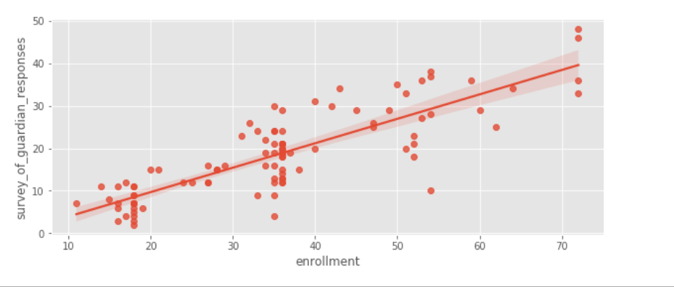
Can a linear model forecast the scores provided by parents?

Slide 7
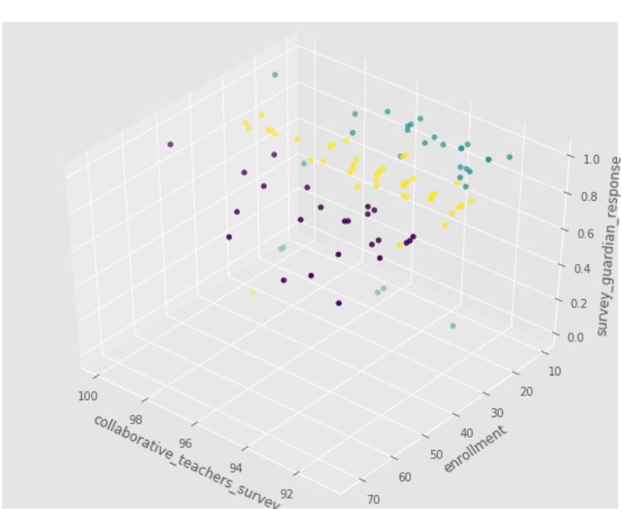
Cluster of data

Slide 8
Model Results
Coefficients: 0.53197729
Intercept: -0.39606296
Mean absolute error: 4.28
Residual sum of squares (MSE): 30.46
R2-score: 0.58
It is not unusual for behavioral models to have R2 of around .5

Slide 9
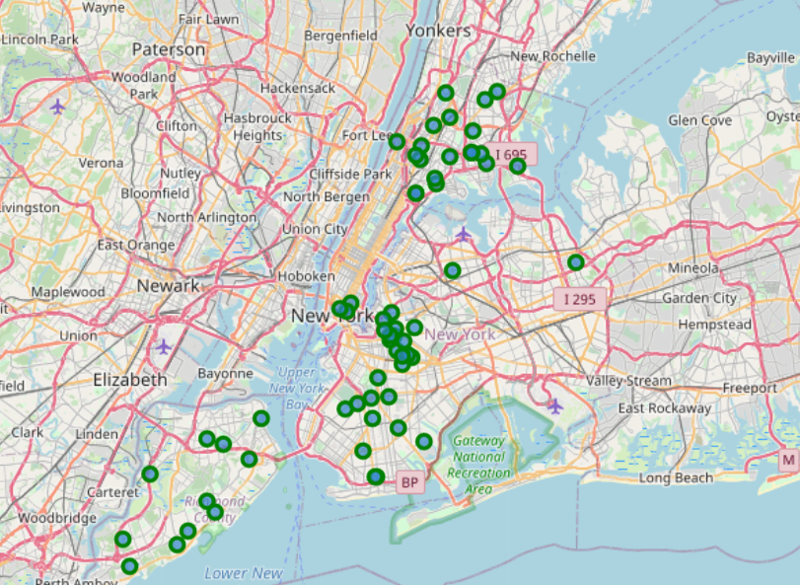
Map of the top schools

